Slide 1
Linear Discriminant Analysis (LDA) in Machine Learning

Slide 2
Linear Discriminant Analysis (LDA) is one of the commonly used dimensionality reduction techniques in machine learning to solve more than two-class classification problems. It is also known as Normal Discriminant Analysis (NDA) or Discriminant Function Analysis (DFA).
This can be used to project the features of higher dimensional space into lower-dimensional space in order to reduce resources and dimensional costs. In this topic

Slide 3
"Linear Discriminant Analysis (LDA) in machine learning”, we will discuss the LDA algorithm for classification predictive modeling problems, limitation of logistic regression, representation of linear Discriminant analysis model, how to make a prediction using LDA, how to prepare data for LDA, extensions to LDA and much more.

Slide 4
What is Linear Discriminant Analysis (LDA)?
Although the logistic regression algorithm is limited to only two-class, linear Discriminant analysis is applicable for more than two classes of classification problems.
Linear Discriminant analysis is one of the most popular dimensionality reduction techniques used for supervised classification problems in machine learning. It is also considered a pre-processing step for modeling differences in ML and applications of pattern classification.
Whenever there is a requirement to separate two or more classes having multiple features efficiently, the Linear Discriminant Analysis model is considered the most common technique to solve such classification problems. For e.g., if we have two classes with multiple features and need to separate them efficiently. When we classify them using a single feature, then it may show overlapping.

Slide 5
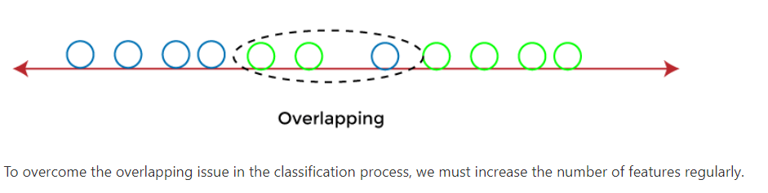

Slide 6
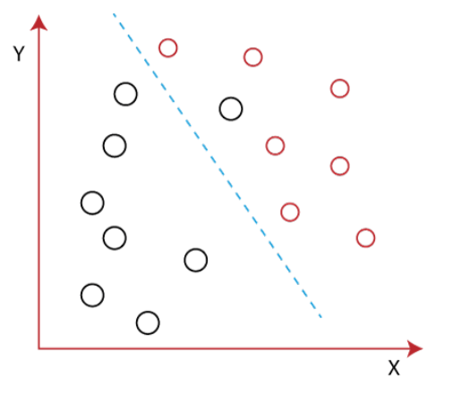
Example:
Let's assume we have to classify two different classes having two sets of data points in a 2-dimensional plane as shown below image:
However, it is impossible to draw a straight line in a 2-d plane that can separate these data points efficiently but using linear Discriminant analysis; we can dimensionally reduce the 2-D plane into the 1-D plane. Using this technique, we can also maximize the separability between multiple classes.

Slide 7
How Linear Discriminant Analysis (LDA) works?
Linear Discriminant analysis is used as a dimensionality reduction technique in machine learning, using which we can easily transform a 2-D and 3-D graph into a 1-dimensional plane.
Let's consider an example where we have two classes in a 2-D plane having an X-Y axis, and we need to classify them efficiently. As we have already seen in the above example that LDA enables us to draw a straight line that can completely separate the two classes of the data points. Here, LDA uses an X-Y axis to create a new axis by separating them using a straight line and projecting data onto a new axis.
Hence, we can maximize the separation between these classes and reduce the 2-D plane into 1-D.

Slide 8
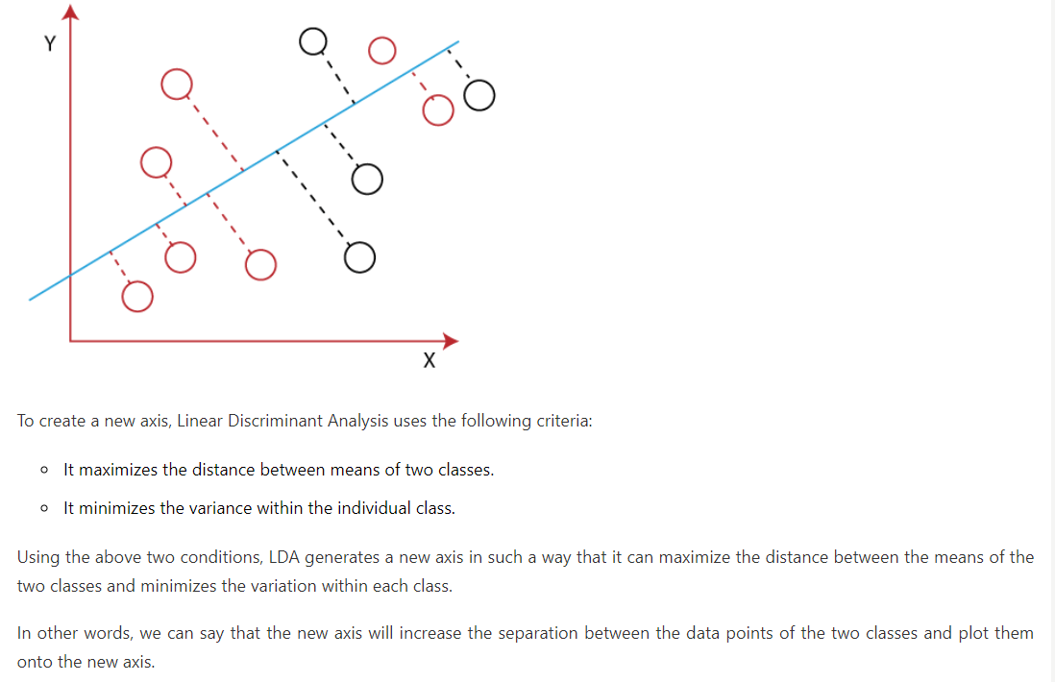

Slide 9
Why LDA?
Logistic Regression is one of the most popular classification algorithms that perform well for binary classification but falls short in the case of multiple classification problems with well-separated classes. At the same time, LDA handles these quite efficiently.
LDA can also be used in data pre-processing to reduce the number of features, just as PCA, which reduces the computing cost significantly.
LDA is also used in face detection algorithms. In Fisherfaces, LDA is used to extract useful data from different faces. Coupled with eigenfaces, it produces effective results.

Slide 10
Drawbacks of Linear Discriminant Analysis (LDA)
Although, LDA is specifically used to solve supervised classification problems for two or more classes which are not possible using logistic regression in machine learning. But LDA also fails in some cases where the Mean of the distributions is shared. In this case, LDA fails to create a new axis that makes both the classes linearly separable.
To overcome such problems, we use non-linear Discriminant analysis in machine learning.

Slide 11
Extension to Linear Discriminant Analysis (LDA)
Linear Discriminant analysis is one of the most simple and effective methods to solve classification problems in machine learning. It has so many extensions and variations as follows:
Quadratic Discriminant Analysis (QDA): For multiple input variables, each class deploys its own estimate of variance.
Flexible Discriminant Analysis (FDA): it is used when there are non-linear groups of inputs are used, such as splines.
Flexible Discriminant Analysis (FDA): This uses regularization in the estimate of the variance (actually covariance) and hence moderates the influence of different variables on LDA.

Slide 12
Real-world Applications of LDA
Some of the common real-world applications of Linear discriminant Analysis are given below:
FaceRecognition Face recognition is the popular application of computer vision, where each face is represented as the combination of a number of pixel values. In this case, LDA is used to minimize the number of features to a manageable number before going through the classification process. It generates a new template in which each dimension consists of a linear combination of pixel values. If a linear combination is generated using Fisher's linear discriminant, then it is called Fisher's face.
Medical In the medical field, LDA has a great application in classifying the patient disease on the basis of various parameters of patient health and the medical treatment which is going on. On such parameters, it classifies disease as mild, moderate, or severe. This classification helps the doctors in either increasing or decreasing the pace of the treatment.
CustomerIdentification In customer identification, LDA is currently being applied. It means with the help of LDA; we can easily identify and select the features that can specify the group of customers who are likely to purchase a specific product in a shopping mall. This can be helpful when we want to identify a group of customers who mostly purchase a product in a shopping mall.
ForPredictions LDA can also be used for making predictions and so in decision making. For example, "will you buy this product” will give a predicted result of either one or two possible classes as a buying or not.
InLearning Nowadays, robots are being trained for learning and talking to simulate human work, and it can also be considered a classification problem. In this case, LDA builds similar groups on the basis of different parameters, including pitches, frequencies, sound, tunes, etc.

